Slide 1

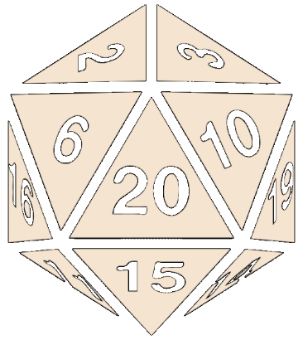

Entropy and Crypto Wallets
Random Seed, Mnemonic Words, BIP39

Slide 2
Internal Seed in Crypto Wallets
Most modern crypto wallets start from a 128 / 256 bits securely generated random seed (see the BIP-39 standard)
The seed (root key) can be represented by 12 or 24 words, e.g.
Each word comes from a wordlist of 2048 words
See https://github.com/bitcoin/bips/blob/master/bip-0039/english.txt
1 word == 11 bits
12 words == 132 bits == 128-bit seed + checksum (in the last word)
24 words == 264 bits == 256-bit seed + checksum (in the last word)
hill brave science fox crime quit owner chapter myth vocal chat custom

Slide 3
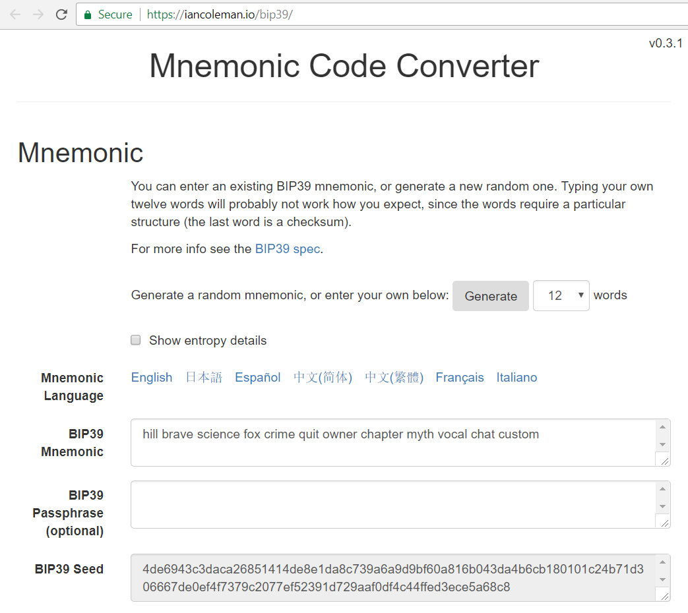
BIP-39 Mnemonic Seed Generator
Live Demo
https://iancoleman.io/bip39

Slide 4
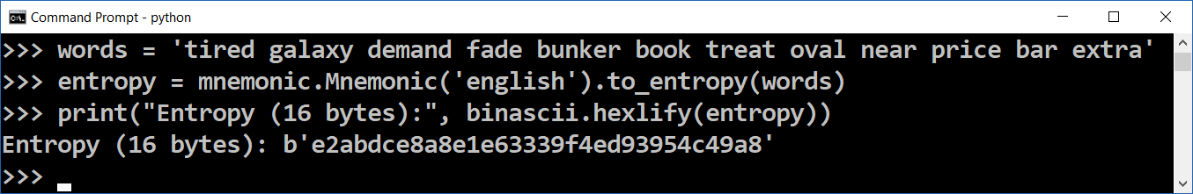
Mnemonic to Entropy / Seed
import mnemonic, binascii
words = 'tired galaxy demand fade bunker book treat oval near price bar extra'
entropy = mnemonic.Mnemonic('english').to_entropy(words)
print("Entropy (16 bytes):", binascii.hexlify(entropy))
seed = mnemonic.Mnemonic.to_seed(words)
print("Seed (64 bytes):", binascii.hexlify(seed))
wordsBack = mnemonic.Mnemonic('english').to_mnemonic(entropy)
print("Mnemonic (12 words):", wordsBack)
pip install mnemonic

Slide 5

Entropy and Crypto Wallets
Try the Code!

